Slide 1
Visualizing real-time data with Azure Database for PostgreSQL Hyperscale

Slide 2
Creating accessible content
Take the following steps to create accessible content that everyone can consume effectively.
Contrast
Use high contrast colors for maximum readability
The recommended contrast ratio is at least 4.5:1
Color Contrast Analyzer
Download this tool to determine the legibility of text and the contrast of visual elements
Shape and color
Use different shapes with a legend to indicate statuses to accommodate for color blindness
Example:
Alt text
Alt text helps people with screen readers understand the content of slides
You can create alternative text for shapes, pictures, charts, tables, SmartArt graphics, or other objects
Here’s how:
Right click the image or shape
Select Format Picture… or Format Shape…
Select the Size & Properties icon
Expand the Alt Text field
Enter a Title and Description of your image or object
Slide layouts
Using a built-in slide layout that matches your content ensures a hierarchical reading order of text blocks
Example:
If a new slide will have a title, rather than starting with a blank layout and adding a text block for the title, choose one of the built-in layouts with a title placeholder
Reading order
Screen readers describe content on the screen in the order it was created
To ensure your content is read back in the order you prefer, arrange your objects in the Selection Pane appropriately. Objects on the bottom of the selection pane are read first
Here’s how:
Click the Home tab
In the Drawing group, select the Arrange drop-down menu
Click Selection Pane…
Text
Text
Text
Subject 1
Subject 2
Subject 3
Download
C1
C2
C3
Additional tips!
Be sure to run the Accessibility Checker! Go to File click the Check for Issues drop down menu click Check Accessibility
Videos need to be accessible: If your presentation includes a video, ensure it is captioned and audio described (if appropriate)
Visit the Office Accessibility Center to learn more about accessibility in PowerPoint

Slide 3

Abstract and learning objectives
Wide World Importers has a host of online stores for various product offerings, including traditional product catalogs offered by their physical storefronts, to specialized categories like automotive and consumer technology products. This expansion has made it more challenging to analyze user clickstream data, online ad performance, and other marketing campaigns at scale, and to provide insights to the marketing team in real-time. Today they store and analyze user clickstream data, online ad performance, and other marketing campaigns to evaluate marketing effectiveness and customer reach.
At the end of this whiteboard design session, you will be better able to use advanced features of the managed PostgreSQL PaaS service on Azure to make your database more scalable and able to handle the rapid ingest of streaming data while simultaneously generating and serving pre-aggregated data for reports. You will design a resilient stream processing pipeline to ingest, process, and save real-time data and provide guidance on how to create complex reports containing advanced visualizations and use them to build a customizable dashboard.

Slide 4
Step 1: Review the customer case study
Outcome
Analyze your customer needs
Timeframe
15 minutes

Slide 5

Customer situation
Wide World Importers (WWI) is a traditional brick and mortar business who has been expanding to several online stores, due to great success world wide in providing excellent customer service.
Online marketing campaigns have been very successful, leading to rapid growth in sales, prompting further investment in marketing efforts.
Wide World
Importers
Notes:
Wide World Importers (WWI) is a traditional brick and mortar business with a long track record of success, generating profits through strong retail store sales of their unique offering of affordable products from around the world. They have a great training program for new employees, that focuses on connecting with their customers and providing great face-to-face customer service. This strong focus on customer relationships has helped set WWI apart from their competitors.
Over time, WWI modernized their business by expanding to online storefronts. During this expansion period, WWI experimented with various marketing tactics to drive online sales, from offering in-store shoppers special discounts online with promotional coupons after making a purchase, to running ad campaigns targeted toward customers based on demographics and shopping habits. These marketing campaigns proved successful, prompting WWI to invest more resources to these efforts and grow their marketing team.

Slide 6
Customer situation
WWI has expanded their traditional product offerings to online storefronts focused on specialized categories like automotive and consumer technology products.
This expansion has made it more challenging to analyze clickstream data, online ad performance, & other marketing campaigns at scale from multiple sources.
Wide World
Importers
Notes:
Today, WWI has a host of online stores for various product offerings, from their traditional product catalogs offered by their physical storefronts, to specialized categories like automotive and consumer technology products. This expansion has made it more challenging to analyze user clickstream data, online ad performance, and other marketing campaigns at scale, and to provide insights to the marketing team in real-time.
Real-time marketing analysis is provided through interactive reports and dashboards on WWI's home-grown web platform, ReMarketable. This platform has served them well, but they are currently hindered by their inability to keep up with demand. ReMarketable's primary users are members of the marketing team, and the secondary users are shoppers on their various online platforms for whom website interaction behavior is being tracked. Other sources of data are fed from online ad data generated by ads run on social media platforms and email marketing campaigns. They use this type of data to evaluate ad effectiveness and customer reach, ultimately leading to sales conversions.

Slide 7



Customer situation
Current challenges:
Scale – historical data growing by almost 3 GB rows of data/month. Queries taking longer to complete
Multi-tenancy – Unbalanced load between various store fronts means multi-tenancy would be preferred, but concerned about increased complexity and maintenance
Process data while generating rollups – Difficulty processing real-time streams and efficiently running aggregate queries for reporting and dashboards. Would like to be able to scale up and out as needed
Notes:
Scale - WWI is using a PostgreSQL database to store ReMarketable's data. Historical data is growing by over 2.9 GB rows of data per month. It is taking consistently longer to run complex queries. Queries that used to run in 3-5 seconds now take several minutes to complete. This is impacting their users' ability to evaluate up-to-date marketing and website use statistics. Instead of providing real-time reports for all users, they have to keep delaying report runs. They have scaled up their database, but this is becoming very expensive and they will soon hit a ceiling.
Multi-tenancy - The nature of their marketing and site usage data would benefit from multi-tenancy. Some storefronts generate considerably more data than others and have more marketing analysts that run reports on them than others. WWI believes sharding their database would help take the pressure off lower-volume data stores and also help them scale out. However, this will require re-engineering their database schema and client applications. In addition, sharding will require additional maintenance and increased complexity of aggregated views. These additional challenges and required resources are why they have not pursued this option yet.
Process data while generating roll-ups - Another byproduct of outgrowing their database is that WWI is having difficulty efficiently processing and ingesting streaming data, while at the same time generating pre-aggregated data for their dashboards. The Postgres engine is well-suited to handle multiple workloads simultaneously when the databases are properly configured and you are able to appropriately scale up or scale out to multiple nodes. WWI does needs help optimizing their database to handle these demanding workloads at scale. They have looked moving to a non-relational database to speed up queries, but that option added too much complexity to manage multiple databases, losing the ability to wrap their operations inside of transactions, re-architect their application, and migrate their historical data. In addition, they rely on Postgres' ability to create complicated ways of representing and indexing their data, which is impossible to do with a column store. Their need for high transaction volume and a real-time data set ruled out a lot of off-the-shelf data warehouses, where they would need to create a lambda architecture to handle both speeds of feeds.

Slide 8


Customer situation
Current challenges:
Resilient stream processing – Currently processing stream data with load-balanced web-based clusters. Processing failures and halted processing results in lost data. Would like a more resilient option that isn’t overly complex
Advanced dashboards – Would like a faster way to create advanced reports and dashboards with compelling visualizations that can be customized and easily shared
Notes:
Resilient stream processing - WWI is processing their streaming data through a web-based cluster that balances HTTP requests in round-robin fashion. When a node is processing the data and writing it to Postgres, subsequent requests are handled by available nodes. However, if processing fails for any reason, they risk losing that data and have no way to pick up where it left off. They have tried creating their own poison queue to reprocess these failed messages, but if the failed node is unable to add the data to the queue, then it is lost. The WWI technical team is aware of existing products and services that can help improve their stream processing and add resiliency, but they currently lack the skills and bandwidth to implement a solution for these complex scenarios. They are interested to see how Azure can help them rapidly create a solution for resilient stream processing and reduce their technical debt.
Advanced dashboards - WWI creates canned reports that are displayed on their ReMarketable website. However, their developers spend a lot of time creating new reports, owing to advanced charts, graphs, and other visualizations that are usually included. They would like a way to more rapidly create reports and be able to display them on a dashboard that can be customized and show real-time updates.

Slide 9
Customer needs
Scale our marketing PostgreSQL database to handle high data growth and reduce time to execute complex queries
Shard database to scale out based on tenants and their load requirements without excess complexity and maintenance overhead
Efficiently ingest and process streaming data while simultaneously generating pre-aggregated data for dashboards
Notes:
Scale our marketing PostgreSQL database to handle high data growth while reducing the amount of time to run complex queries.
Shard our database so we can scale out, based on our tenants and their load requirements. We need a way to do this that will reduce schema changes, maintenance, and complexity of aggregated views.
Need a way to efficiently ingest and process streaming data, while at the same time generating pre-aggregated data for our dashboards.

Slide 10
Customer needs
More resilient stream processing solution to prevent lost data and continue where left off
Simple way to create powerful reports with advanced visualizations
Notes:
During our stream processing, we sometimes encounter errors and have a difficult time recovering and continuing where we left off. We need a more resilient stream processing solution to reduce errors and prevent lost data.
Would like a simple way to create powerful reports with a variety of visualizations. Ideally, this is something our analysts should be able to do against our live data sets.

Slide 11

Customer objections
Does Azure provide managed PostgreSQL that can handle our scale requirements?
Worried about re-engineering efforts involved in sharding our database, including application changes
How can we migrate to PostgreSQL on Azure with minimal downtime?
Have looked at other similar solutions, but concerned about compatibility with existing applications & having access to latest versions
Notes:
Does Azure offer a managed PostgreSQL database that can handle our scale requirements?
We are worried about the re-engineering effort involved in sharding our database, from modifying the schema to updating our applications to account for the changes.
Is there a way to migrate to PostgreSQL on Azure with minimal downtime?
We've looked at several PostgreSQL-based data platforms for adding enhancements like distributed data and scalability, but we are concerned about our existing applications being compatible and having access to the latest versions of PostgreSQL.

Slide 12
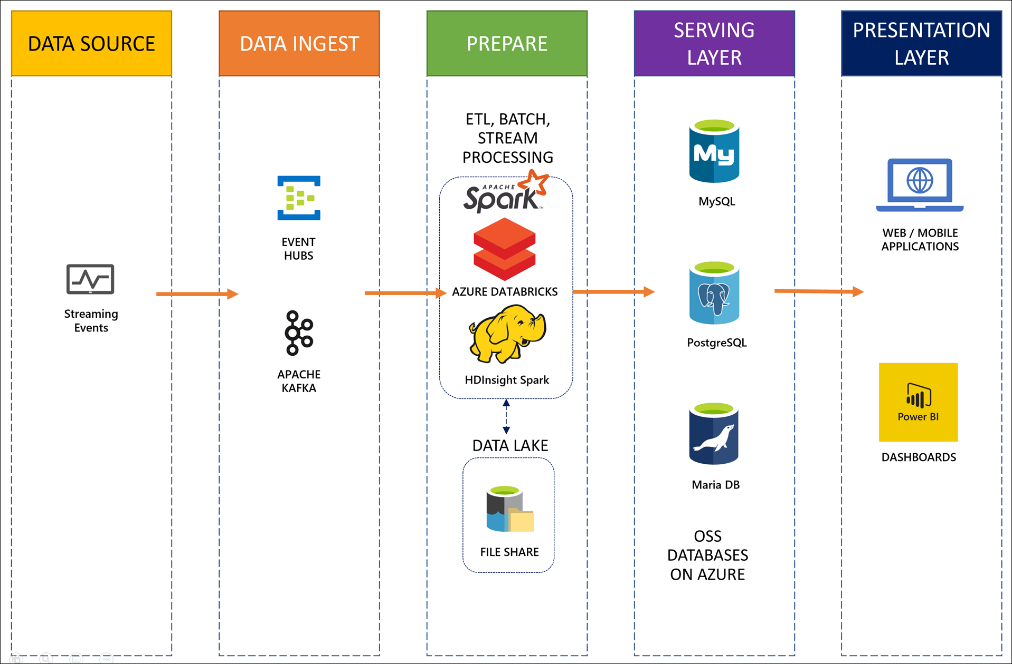
Common scenarios

Slide 13
Step 2: Design the solution
Outcome
Design a solution and prepare to present the solution to the target customer audience in a 15-minute chalk-talk format.
Timeframe
60 minutes
Business needs (10 minutes) | Respond to questions outlined in your guide and list the answers on a flipchart
Design (35 minutes) | Design a solution for as many of the stated requirements as time allows. Show the solution on a flipchart
Prepare (15 minutes) | Identify any customer needs that are not addressed with the proposed solution Identify the benefits of your solution Determine how you will respond to the customer’s objections Prepare for a 15-minute presentation to the customer

Slide 14
Step 3: Present the solution
Outcome
Present a solution to the target customer in a 15-minute chalk-talk format
Timeframe
30 minutes (15 minutes for each team to present and receive feedback)
Directions
Pair with another table
One table is the Microsoft team and the other table is the customer
The Microsoft team presents their proposed solution to the customer
The customer asks one of the objections from the list of objections in the case study
The Microsoft team responds to the objection
The customer team gives feedback to the Microsoft team

Slide 15
Wrap-up
Outcome
Identify the preferred solution for the case study
Identify solutions designed by other teams
Timeframe
15 minutes

Slide 16

Preferred target audience
Charlene Mathis, Chief Information Officer, Wide World Importers
The primary audience is business decision makers and technology decision makers.
Usually, we talk to the Database Administrators and Infrastructure Managers who report into the CIOs, or to application sponsors (like a VP LOB, CMO) or to those that represent the Business Unit IT or developers that report into application sponsors.

Slide 17
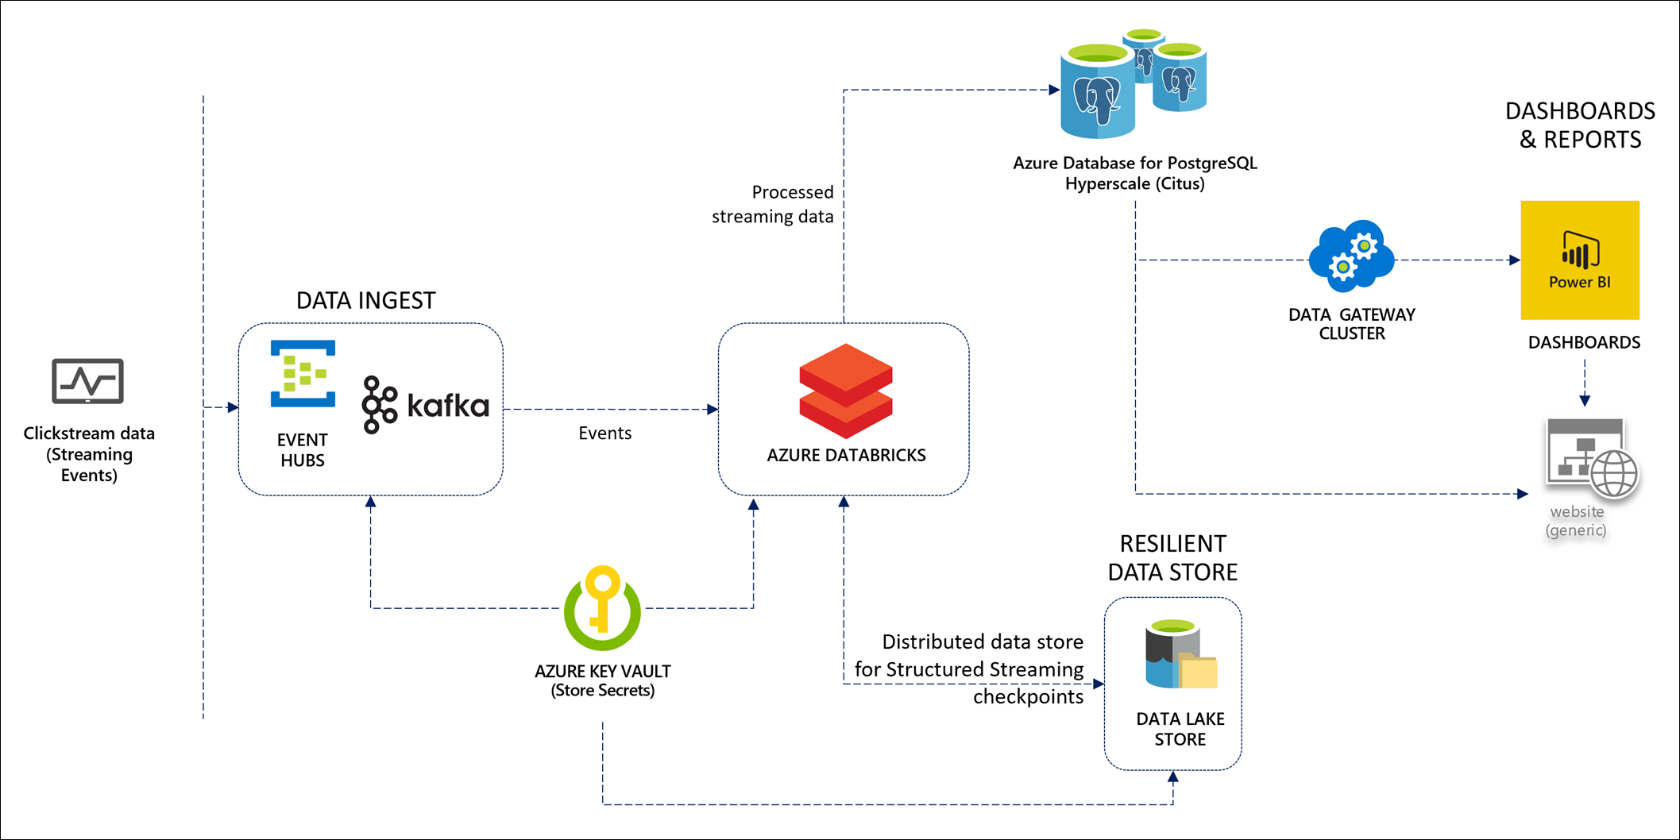
Preferred solution - overall
Notes:
The solution begins with multiple sources of clickstream data, each from a different tenant, flowing in through a Kafka streaming ingest managed service provided by Azure Event Hubs. This allows Wide World Importers to continue using their existing code to produce Kafka events. An Apache Spark cluster running on Azure Databricks processes and transforms the data in real time, using Structured Streaming. Azure Data Lake Storage is used to store the Structured Streaming checkpoint for resiliency to recover from errors and prevent lost data. Azure Key Vault is used to securely store secrets, such as the Event Hubs and PostgreSQL connection strings, and serves as a backing for Azure Databricks secret scopes. All event data is stored written to an Azure Databricks for PostgreSQL managed Hyperscale (Citus) database cluster, offering both scale-up and scale-out capability with features that simplify sharding and partitioning time series and multi-tenant data. Data is periodically written to rollup tables, using a background process that runs on a scheduled basis, to provide extremely fast querying of pre-aggregated data that does not interfere with incoming streams of late-arriving data. Websites and Power BI reports and dashboards use this data to provide rich reports that can be run at scale with minimum processing time. An on-premises data gateway cluster runs on several VMs to update the Power BI dashboards at regular intervals to match the pre-aggregation processes that write to the rollup tables.

Slide 18

Preferred solution
Scale
Use Azure Database for PostgreSQL Hyperscale (Citus) server group that allows you to scale out compute across multiple nodes, easily shard and partition the data, while maintaining maximum compatibility
Can scale up by assigning more vCores and storage to coordinator and worker nodes (up to 32 vCores w/ 8 GiB RAM/core and up to 2 TiB/storage with up to 3 IOPS / GiB per node)
Can scale out by defining number of worker nodes between 2 and 20 (or more if you contact support)
Notes:
How will you configure the managed PostgreSQL database so it can be scaled to meet demand. Think about options for scaling up and for scaling out.
Azure Database for PostgreSQL is a fully managed service built on the open source PostgreSQL database engine. It provides high availability and performance with monitoring and alerting, enterprise-grade security and compliance, automatic backups, data secured at-rest and in-motion, and full compatibility with PostgreSQL extensions with little to no administration required.
Hyperscale clusters are enabled by Citus, which is an extension of PostgreSQL that allows you to horizontally scale queries across multiple machines, using sharding and partitioning techniques. Because of this, the query engine parallelizes incoming SQL queries across these servers for faster response times on large datasets. Data sharding is transparently handled for you and allows your existing PostgreSQL applications to take advantage of the benefits distributed data storage and querying provides, with minimal changes. This means that Wide World Importer's multi-tenant, real-time operational analytics requirements will be met with little effort on their part.
A Hyperscale server group (database cluster) consists of a coordinator node and several worker nodes. To scale up, you define the number of cores and storage you require per coordinator node and worker node. You can select up to 32 vCores with 8 GiB RAM per vCore and up to 2 TiB of storage with up to 3 IOPS / GiB per node. To scale out, you can define the number of worker nodes, between 2 and 20. If you require more than 20 worker nodes, you can submit a support request.
You can define the compute and storage settings independently for your nodes, giving you flexibility by adding more of one or the other depending on your needs. The storage includes database files, temporary files, transaction logs, and the Postgres server logs. The total amount of storage you provision also defines the I/O capacity available to each worker and coordinator node.

Slide 19
Preferred solution
Scale
Sharding logic is automatically handled by the Hyperscale server group (enabled by Citus), allowing for scaling across multiple managed PostgreSQL servers
Multi-tenancy provided by sharding by Tenant ID, keeping data co-located automatically
Queries are parallelized across shards, including aggregations written to rollup tables
Sharding is transparent to you, meaning very minor changes to schema and virtually no impact to existing applications
Notes:
WWI wants to be able to scale their database out, but they've already expressed concerns about how sharding tables to accomplish this adds a lot of complexity and maintenance overhead, as well as required code changes. How would you propose they shard tables that need to have data distributed amongst the nodes?
The sharding logic is handled for you by the Hyperscale server group (enabled by Citus), allowing you to horizontally scale your database across multiple managed Postgres servers. This provides you with multi-tenancy because the data is sharded by the same Tenant ID. Because we are sharding on the same ID for our raw events table and rollup tables, our data stored in both types of table are automatically co-located for us by Citus. Furthermore, this means that aggregations can be performed locally without crossing network boundaries when we insert our events data into the rollup tables. The dashboard queries that execute against the rollup tables are always for a particular tenant. Hyperscale clusters allow us to parallelize our aggregations across shards, then perform a SELECT on a rollup for a particular customer from the dashboard, and have it automatically routed to the appropriate shard.
Because the sharding is transparently handled for you, WWI will be able to start using this capability with very minor changes to their schema and mostly without impacting their existing applications.

Slide 20
Preferred solution
Scale
Time series event data can be partitioned into 5-minute increments to avoid large indexes by using the pg_partman utility
Choose Tenant ID instead of timestamp as distribution column for sharding. Use table partitioning for time instead
--Create 5-minutes partitions
SELECT partman.create_parent('public.events', 'event_time', 'native', '5 minutes’);
UPDATE partman.part_config SET infinite_time_partitions = true;
Notes:
How can the clickstream time series event data be partitioned into 5-minute increments to avoid creating large indexes?
This event data table can be partitioned by a timestamp, such as event_time, for the time series data. The sample script below creates a partition every 5 minutes, using pg_partman.
Partitioning is the key to high performance and being able to scale out across several database nodes. One of the keys to fast data loading is to avoid using large indexes. Traditionally, you would use block-range (BRIN) indexes to speed up range scans over roughly-sorted data. However, when you have unsorted data, BRIN indexes tend to perform poorly. Partitioning helps keep indexes small. It does this by dividing tables into partitions, avoiding fragmentation of data while maintaining smaller indexes.

Slide 21

Preferred solution
Multi-tenancy
WWI can shard the raw events and rollup tables by Tenant ID by defining a distribution column to indicate which tenant owns the rows (tenant_id):
The Hyperscale deployment option handles distribution across all nodes of the cluster. You do not need knowledge of this distribution when executing queries
SELECT create_distributed_table('events','tenant_id');
Notes:
The clickstream event data is multi-tenant by nature. Each tenant is denoted by a Tenant ID which is related to the source of the clickstream feed. How can WWI shard the raw event table by tenant across multiple nodes in a way that causes little impact to existing applications and maintenance overhead?
As mentioned earlier, WWI can shard their data based on Tenant ID. When you use the create_distributed_tablefunction, you define the distributed table name (such as events) and a distribution column to define which tenant owns which rows (such as tenant_id):
SELECT create_distributed_table('events','tenant_id’);
The hyperscale deployment handles the distribution, or sharding, for you across all of the cluster's nodes. As stated before, you do not need to have knowledge of how the data is distributed when you read from or write to these tables.

Slide 22
Preferred solution
Multi-tenancy
WWI can create rollup tables, sharded by tenant ID as well. Since rollup tables tend to contain counts of distinct values, it is highly recommended to use HyperLogLog (HLL) data types to very rapidly calculate distinct counts with tunable precision. With HLL, can rapidly estimate count of 10s of billions of distinct values with only a few percent error
HLL overcomes the overlapping records problem by encoding the data in a way that allows summing up individual unique counts without re-counting overlapping records. When we write data to the HLL columns, we also hash it to ensure uniform distribution
Notes:
WWI has expressed a desire to create rollup tables that contain pre-aggregated data for efficient reporting. These rollup tables should also be sharded by Tenant ID. How can WWI shard these tables as well and what data type can be used to rapidly obtain distinct counts within a small margin of error in a highly scalable way across partitions?
WWI will shard the rollup tables in the same way they shard the events table Another important thing to note about the rollup tables is that it is highly recommended to use HyperLogLog (HLL) data types to very rapidly obtain distinct counts for devices and sessions (device_distinct_count and session_distinct_count). HyperLogLog is a fixed-size data structure that is extremely fast at estimating distinct value counts with tunable precision. For example, in 1280 bytes HLL can estimate the count of tens of billions of distinct values with only a few percent error (source).
It is very common to run SELECT COUNT(DISTINCT) on your database to update a dashboard with the number of unique items such as unique purchases of a particular item, unique users, unique page visits, etc. However, when you are using distributed systems, as Wide World Importers is in this situation, calculating unique counts is a difficult problem to solve. One reason for this is that there can be overlapping records across the workers. You could get around this by pulling all the data into a single machine and perform the count, but this does not scale well. Another option is to perform map/reduce functions, which scales, but are very slow to execute. The better option that provides scalability and speed is to use approximation algorithms to provide distinct count results within mathematically provable error bounds. This is why we are using HyperLogLog.
If we were not using HLL, we would be limited to creating a large number of rollup tables. You would need rollup tables for various time periods, and rollup tables to calculate the distinct counts constrained by combinations of columns. For example, if you pre-aggregate over minutes, then you cannot answer queries asking for distinct counts over an hour. If you try and each minute's result to find hourly visits to a specific page, for example, the result will be unreliable because you are likely to have overlapping records within those different minutes. This problem is further complicated when you want to return a count of page visits filtered by time and unique page visit counts by user or a combination of the two. HLL allows us to use one or two rollup tables to answer all of these queries and more. This is because HLL overcomes the overlapping records problem by encoding the data in a way that allows summing up individual unique counts without re-counting overlapping records. When we write data to the HLL columns, we also hash it to ensure uniform distribution.

Slide 23

Preferred solution
Process data while generating roll-ups
Create rollup aggregation functions that can be scheduled to run on a periodic basis using pg_cron
The cron notation makes it simple to schedule execution in a number of ways, such as minutely, hourly, daily, weekly, monthly, day of week, etc.
SELECT cron.schedule('*/5 * * * *', 'SELECT five_minutely_aggregation();');
Notes:
Rollup tables enable faster queries for reporting and exploration, but oftentimes require compute-heavy work to periodically run in the background to populate these tables. How would you schedule these aggregates to run on a periodic basis?
WWI will create rollup aggregation functions that can be scheduled to run on a periodic basis using pg_cron.
The cron notation makes it simple to schedule execution in a number of ways, such as minutely, hourly, daily, weekly, monthly, day of week, etc.

Slide 24
Preferred solution
Process data while generating roll-ups
Decide between append-only aggregations or incremental aggregations. Incremental aggregations more easily handle late-arriving events at expense of fewer aggregate options
Incremental aggregations support late events by using ON CONFLICT ... DO UPDATE in the INSERT statement
Recommended approach to keep track of aggregated events is to store monotonically increasing sequence numbers in a table, briefly block writes to ensure no more in-flight transactions using sequence numbers, aggregate events within range and repeat during each upsert
Notes:
Within your rollup functions that perform the background aggregations, how would you implement incremental aggregations to handle late, incoming, data while keeping track of which time periods have been aggregated already?
Rollups are an integral piece of this solution because they provide fast, indexed lookups of aggregates where compute-heavy work is performed periodically in the background. Because these rollups are compact, they can easily be consumed by various clients and kept over longer periods of time.
Use incremental aggregation to support late, or incoming, data. This is accomplished by using ON CONFLICT ... DO UPDATE in the INSERT statement.
When executing aggregations, you have the choice between append-only or incremental aggregation. Append-only aggregation (insert) supports all aggregates, including exact distinct and percentiles, but are more difficult to use when handling late data. This is because you have to keep track of which time periods have been aggregated already, since you aggregate events for a particular time period and append them to the rollup table once all the data for that period are available. Incremental aggregation (upsert), on the other hand, easily supports processing late data. The side effect is that it cannot handle all aggregates. We work around this limitation by using highly accurate approximation through HyperLogLog (HLL) and TopN. As stated previously, WWI will be aggregating new events and upserting them to the rollup tables. They still need to be able to keep track of which events have already been aggregated.
One way to keep track of which events have already been aggregated is to mark them as aggregated (SET aggregated = true). The problem with this approach is that it causes bloat and fragmentation. Another way would be to use a staging table to temporarily store events. This can cause catalog bloat and high overhead per batch, depending on how often your aggregation is run. The recommended approach is to track the sequence number. This means that each event has a monotonically increasing sequence number (i). We store sequence number S up to the point in which all events were aggregated. To aggregate, we pull a number from the sequence (E), briefly block writes to ensure there are no more in-flight transactions using sequence numbers <= E (EXECUTE format('LOCK %s IN EXCLUSIVE MODE', table_to_lock)), then incrementally aggregate all events with sequence numbers S < i <= E. Finally, we set S = E and repeat this process on each upsert. You can see exactly how we're doing this in the incremental_rollup_window function below. The rollups table keeps track of the sequence for us. The five_minutely_aggregation and hourly_aggregation functions call incremental_rollup_window to retrieve the range of page views that can be safely aggregated, using the start and end event_id values (start_id and end_id).

Slide 25
Preferred solution
Process data while generating roll-ups
Advanced aggregation options can be used with incremental aggregations to provide highly accurate approximation: HyperLogLog (HLL) and TopN
Use HLL hash functions like hll_has_bigint to produce uniformly distributed bit strings by dividing values into streams and averaging results. The hll_add_agg and hll_union functions are used to do incremental rollups
TopN keeps track of a set of counters in JSONB to determine top N (like top 10) items (heavy hitters) The topn_union function merges TopN objects over time periods and dimensions
Notes:
Incremental aggregations sacrifice the ability to handle all types of aggregates for ease of use when tracking what has already been aggregated when processing late data. What advanced aggregation options can you use to provide highly accurate approximation in this situation?
Advanced aggregation is accomplished by using HyperLogLog (HLL) and TopN, as discussed earlier. For this topic, reference the five_minutely_aggregation function above. Also, please note that where you see the special excludedtable in the query, it is used to reference values originally proposed for insertion. We are using hll_has_bigint to hash the HLL columns device_id and session_id. This hash function produces a uniformly distributed bit string. HLL does this by dividing values into streams and averaging the results. The hll_add_agg and hll_union are used to do incremental rollups. TopN keeps track of a set of counters in JSONB with the explicit goal of determining the top N (like top 10) items (or our "heavy hitters"). In our case, we're using it to return the top 1000 devices by device_id. Similar to HLL, we are using topn_add_agg and topn_union to do incremental rollups. The topn_union function merges TopN objects over time periods and dimensions.

Slide 26


Preferred solution
Resilient stream processing
Use Azure Event Hubs to ingest high volume of data
Fully managed and capable of ingesting millions/events per second
Can scale on demand
Fully supports Apache Kafka 1.0 and greater protocols, allowing WWI to continue using their existing applications to write to Event Hubs-backed Kafka service
Notes:
WWI is currently using a Kafka cluster to ingest a high volume of streaming data from various clickstream sources across their tenants. Is there a managed option in Azure that supports Kafka?
Azure Event Hubs is a Big Data streaming platform that is capable of ingesting millions of events per second. It is fully managed and contains controls you can use to either scale it on demand or have it automatically scale to pre-defined thresholds. It provides an Apache Kafka endpoint you can enable, expanding its protocol options to HTTPS, AMQP, and Apache Kafka 1.0 and above. The Kafka endpoint would allow WWI to use their existing applications to write to the Event Hubs-backed Kafka service.

Slide 27


Preferred solution
Resilient stream processing
Use Apache Spark on Azure Databricks with Structured Streaming to efficiently process all streaming events coming from the Event Hubs-backed Kafka service in real-time
Clusters are fully managed and can be shut down when not used with sub-second billing
Enable checkpointing for a streaming query, pointing at Azure Data Lake Storage Gen2 account to store checkpoints in a fast and distributed way
Checkpointing allows you to restart the streaming query after failure and pickup where left off to prevent data loss
Azure Databricks
Notes:
WWI sometimes encounters errors while stream processing, and has a difficult time recovering and continuing where they left off if the stream has to stop for any reason. What would you recommend for a resilient stream processing solution to reduce errors and prevent lost data?
Apache Spark is the de facto standard in Big Data processing that is built to conduct batch, interactive, and real-time processing using the same core engine. This gives you the benefit of having a unified framework for processing these varying latencies (speeds) of Big Data, as well as being able to conduct machine learning, deep learning, graph processing, and advanced analytics in one place. Spark has become a leader in the data engineering and data science industry due to its ease of use, large ecosystem of tools and libraries, and for the fact that it runs batch and streaming workloads 100x faster than Hadoop on average. Azure Databricks provides one of the best options for running Spark on managed clusters in Azure.
WWI can connect to the Kafka endpoint provided by Event Hubs, directly from a Databricks notebook, and use Spark Structured Streaming to process the data in real-time. Azure Key Vault can be used to secure secrets, such as the Kafka and PostgreSQL connection strings and be used as a backing store for a Databricks secret store. This will prevent any accidental leakage of these secrets.
In Structured Streaming, if you enable checkpointing for a streaming query, then you can restart the query after a failure and the restarted query will continue where the failed one left off, while ensuring fault tolerance and data consistency guarantees. If you do not have a checkpoint directory, when the streaming job stops, you lose all state around your streaming job and upon restart, you start from scratch.
The Databricks clusters can be configured to mount an Azure Data Lake Storage Gen2 account for fast-distributed storage of the streaming checkpoints, as well as any long-term storage needs when using Azure Databricks for Big Data analytics.

Slide 28

Preferred solution
Resilient stream processing
Apache Spark offers a unified platform for performing batch, interactive query, and real-time stream processing
You can use Python, Scala, SQL, and R
Clusters are easily created and can be based on standard, compute or memory-optimized, or GPU-based VMs
Use the included org.postgresql.Driver driver to connect to PostgreSQL database
Azure Key Vault can be used to secure secrets, such as the Kafka and PostgreSQL connection strings and be used as a backing store for a Databricks secret store
Azure Databricks
Azure Key Vault
Notes:
Could your chosen stream processing solution also provide the ability to conduct batch processing against large amounts of data while sharing much of the data processing and cleansing code, as well as code to write data to PostgreSQL?
As stated in the previous answer, Apache Spark offers a unified platform for performing batch, interactive query, and real-time stream processing. Clusters are defined by selecting VM sizes and capabilities (compute or memory-optimized, GPU, etc.), as well as the number of worker nodes for scaling out Spark processing to handle demanding workloads. You can use Python, Scala, SQL, and R, along with a broad ecosystem of libraries you can use for data manipulation and advanced analytics.
To connect to PostgreSQL from Azure Databricks, you can use the included org.postgresql.Driver driver and connect to it with a simple JDBC connection string that can be securely stored in Azure Key Vault and access from within a notebook or library.

Slide 29

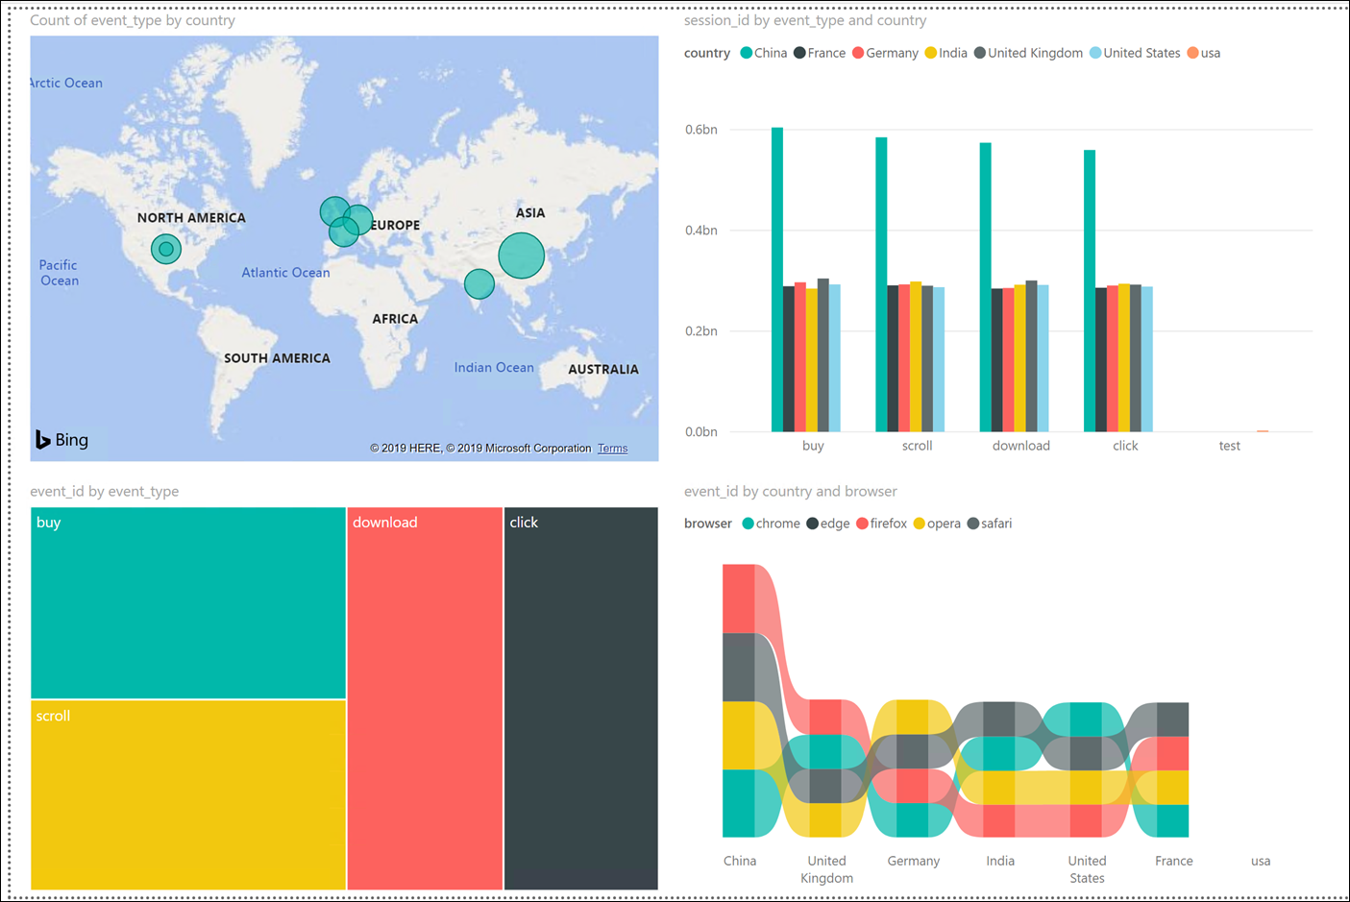
Preferred solution
Advanced dashboards
Use Power BI to easily create advanced visualizations through a drag-and-drop interface with several out-of-the-box components like maps, multiple charts, slicers, custom R and Python components, etc.
Start by creating report using Power BI Desktop to connect to PostgreSQL database cluster
Optionally publish to Power BI online service to invite collaborators to modify report, create dashboards, modify for mobile, and embed within external websites and mobile devices
Notes:
What would you recommend Wide World Importers use to create reports and dashboards with advanced visualizations, that can be created with an intuitive visual interface, easily shared with others, embedded in external websites or mobile devices?
Power BI could be used to create reports and static or real-time dashboards from multiple on-premises and cloud-based services, such as Azure Database for PostgreSQL. WWI can use it to create advanced visualizations through a drag-and-drop interface with several out-of-the-box components, like maps, multiple charts, slicers, custom R and Python components, etc. They would start out by creating the report using Power BI Desktop to connect to the PostgreSQL database cluster, then optionally publish the report to the Power BI online service. From there, they can invite collaborators to modify the report, create a dashboard, modify for mobile form factors, and embed the report within external websites and mobile devices.

Slide 30
Preferred solution
Advanced dashboards
Power BI does not currently support DirectQuery or live updates from PostgreSQL sources
The data source can be refreshed manually, or automatically using on-premises data gateway
Install on multiple servers or VMs to create a highly available cluster
Gateway cloud service securely stores credentials
Communication flows one way from source to cloud, so no need to open inbound traffic on VMs or firewalls
Power BI standard allows 8 refreshes/day, premium 48/day
Notes:
How can WWI refresh the report's data on a regular basis and provide redundancy in their synchronization process? Does this synchronization process require any inbound ports to be opened up on the computer or servers on which it runs?
At this time, PostgreSQL data sources do not support DirectQuery or live updates in Power BI. However, the data source can be refreshed either manually or at regular intervals with an on-premises data gateway. The gateway can be installed on individual computers, but WWI would want to install them on servers or hosted VMs. When you add additional gateways, they act together as a highly available cluster. Behind the scenes, the gateway cloud service securely encrypts stores the data source credentials, and manages an Azure Service Bus instance to securely and resiliently secure data transfers between the cloud and gateways. This communication flows one way from the source gateways to the cloud. This way, it is not required to open any inbound traffic on the VMs or on-premises firewalls.
WWI can perform multiple dataset refreshes daily to their PostgreSQL database cluster. Power BI limits datasets on shared capacity to eight daily refreshes. If the dataset resides on a Premium capacity, they can perform up to 48 refreshes per day.

Slide 31
Preferred objections handling
Does Azure offer a managed PostgreSQL database that can handle our scale requirements?
Yes! The new Azure Database for PostgreSQL Hyperscale (Citus) option allows you to configure scaling up and scaling out the nodes of your database cluster. It is ideal for applications that require greater scale and performance than the single server option, and generally for workloads that are at or beyond 100 GB of data.
Notes:
Does Azure offer a managed PostgreSQL database that can handle our scale requirements?
Yes! The new Azure Database for PostgreSQL Hyperscale (Citus) option allows you to configure scaling up and scaling out the nodes of your database cluster. It is ideal for applications that require greater scale and performance than the single server option, and generally for workloads that are at or beyond 100 GB of data.

Slide 32
Preferred objections handling
We are worried about the re-engineering effort involved in sharding our database, from modifying the schema to updating our applications to account for the changes.
Sharding logic automatically handled by the Hyperscale server group. Sharding helps horizontally scale database across multiple managed servers, implement multi-tenancy where data stored with same tenant ID is automatically co-located. Aggregations and queries are parallelized across shards, and queries based on tenants are automatically routed to the appropriate shard. All this can be done with minimal changes to schema and code.
Notes:
We are worried about the re-engineering effort involved in sharding our database, from modifying the schema to updating our applications to account for the changes.
The sharding logic is automatically handled for you by the Hyperscale server group. WWI wants to use sharding because it allows them to horizontally scale their database across multiple managed Postgres servers. Another reason they want to use sharding is for multi-tenancy. They should configure the distribution column to be the Tenant ID. When this same ID is used in the events table as well as rollup tables, the data stored in both types of table are automatically co-located by Citus. Hyperscale clusters will allow them to parallelize their aggregations across shards, then perform a SELECT on a rollup for a particular tenant from the dashboard, and have it automatically routed to the appropriate shard. All of this can be done with minimal schema and code changes.

Slide 33
Preferred objections handling
Is there a way to migrate to PostgreSQL on Azure with minimal downtime?
Yes. This can be accomplished by using Azure Data Migration Service (DMS) with the continuous sync capability. The basic steps are that DMS performs an initial load of your source data to your Azure Database for PostgreSQL database. From there any new transactions are continuously synchronized to Azure while the application remains running. After the data catches up, briefly stop the application, wait for the last batch of data to catch up to the target, then change your application's connection string to point to the new database on Azure.
Notes:
Is there a way to migrate to PostgreSQL on Azure with minimal downtime?
Yes. This can be accomplished by using Azure Data Migration Service (DMS) with the continuous sync capability. The basic steps are that DMS performs an initial load of your source data to your Azure Database for PostgreSQL database. From there any new transactions are continuously synchronized to Azure while the application remains running. After the data catches up, briefly stop the application, wait for the last batch of data to catch up to the target, then change your application's connection string to point to the new database on Azure.

Slide 34
Preferred objections handling
We've looked at several PostgreSQL-based data platforms for adding enhancements like distributed data and scalability, but we are concerned about our existing applications being compatible and having access to the latest versions of PostgreSQL.
The Hyperscale option uses Citus to provide capabilities like sharding, query routing, and query parallelization. However, it is built as an extension of PostgreSQL, not a forked version with that has to be modified every time there's a new version of PostgreSQL. Because of this, WWI can continue using the latest versions of PostgreSQL and maintain full compatibility with the single server option and standard connection libraries.
Notes:
We've looked at several PostgreSQL-based data platforms for adding enhancements like distributed data and scalability, but we are concerned about our existing applications being compatible and having access to the latest versions of PostgreSQL.
The Hyperscale option uses Citus to provide capabilities like sharding, query routing, and query parallelization. However, it is built as an extension of PostgreSQL, not a forked version with that has to be modified every time there's a new version of PostgreSQL. Because of this, WWI can continue using the latest versions of PostgreSQL and maintain full compatibility with the single server option and standard connection libraries.

Slide 35
Customer quote
“Migrating our PostgreSQL databases to Azure with the Hyperscale (Citus) deployment option has both simplified our initial plans of manually sharding our databases and handling multitenancy, while greatly increasing the performance of our most complex queries. The combination of services Microsoft has helped us use to build a resilient and scalable real-time data processing pipeline enabled us to put in place a future-proof design under budget and in record time.”
Charlene Mathis, CIO, Wide World Importers

